Slide 1
Integrity constraints

Slide 2
Integrity constraints are a set of rules. It is used to maintain the quality of information.
Integrity constraints ensure that the data insertion, updating, and other processes have to be performed in such a way that data integrity is not affected.
Thus, integrity constraint is used to guard against accidental damage to the database.

Slide 3
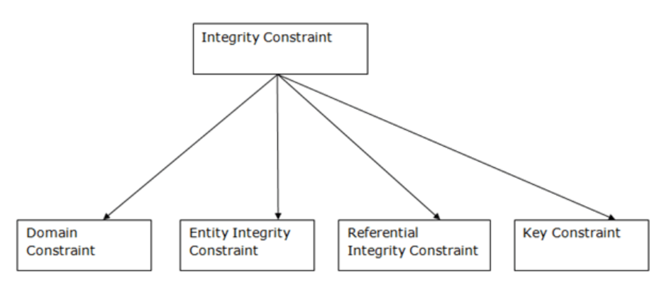

Slide 4
1. Domain constraints
Domain constraints can be defined as the definition of a valid set of values for an attribute.
The data type of domain includes string, character, integer, time, date, currency, etc. The value of the attribute must be available in the corresponding domain

Slide 5
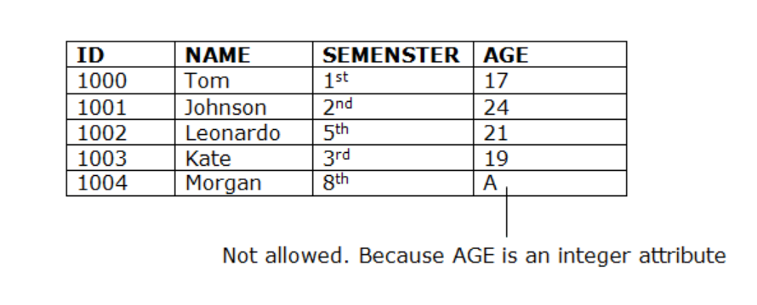

Slide 6
2. Entity integrity constraints
The entity integrity constraint states that primary key value can't be null.
This is because the primary key value is used to identify individual rows in relation and if the primary key has a null value, then we can't identify those rows.
A table can contain a null value other than the primary key field.

Slide 7
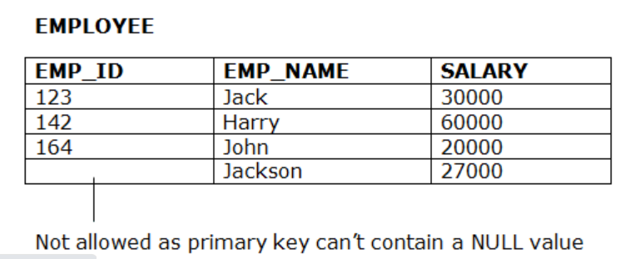

Slide 8
3. Referential Integrity Constraints
A referential integrity constraint is specified between two tables.
In the Referential integrity constraints, if a foreign key in Table 1 refers to the Primary Key of Table 2, then every value of the Foreign Key in Table 1 must be null or be available in Table 2.

Slide 9
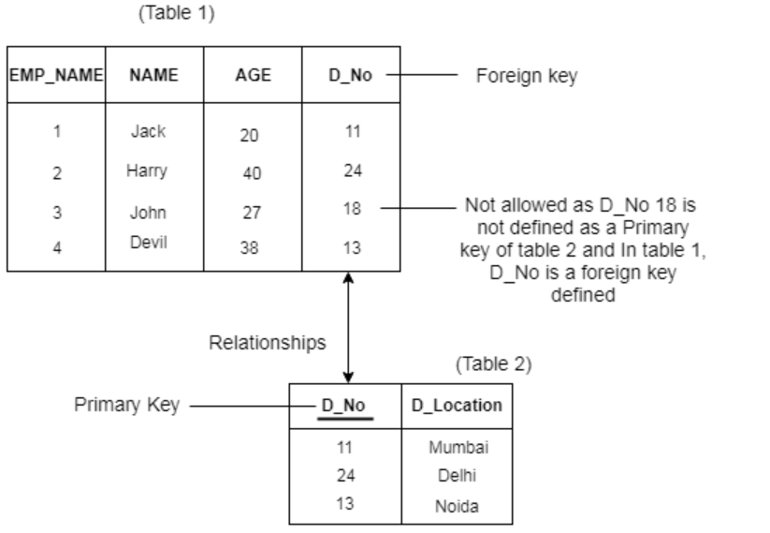

Slide 10
4. Key constraints
Keys are the entity set that is used to identify an entity within its entity set uniquely.
An entity set can have multiple keys, but out of which one key will be the primary key. A primary key can contain a unique and null value in the relational table.

Slide 11
